Slide 1
Specialised Plant Cells- Root Hairs and Conducting Cells

Slide 2
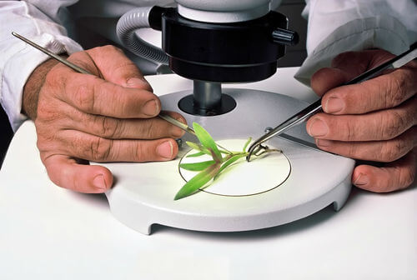
In this Smart Lesson, you will be doing the following:
1. | Describing the structure of 2 types of specialised plant cells: root hairs and conducting cells.
2. | Explaining the function of these specialised cells.
3. | Comparing and contrasting the structure and function of specialised plant cells.

Slide 3

All plant cells work together to help the plant grow.
A plant's roots are covered in specialised root hairs, which absorb water from the soil.
This water is transferred to the leaves through specialised conducting cells.
Carbon dioxide is absorbed using specialised guard cells in the leaves.
The water and carbon dioxide is turned into food by the specialised photosynthetic cells, using sunlight.

Slide 4
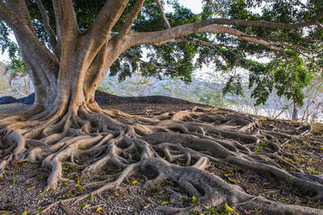
Plants cannot move around to get water, so they must absorb as much water from the soil as possible.
They achieve this by having an extensive root system.

Slide 5

Plants absorb enough water to survive by having highly branched roots.
Water in the soil is absorbed through the surface of the plant's roots. The more branches in the roots, the more surface is available to absorb water.

Slide 6
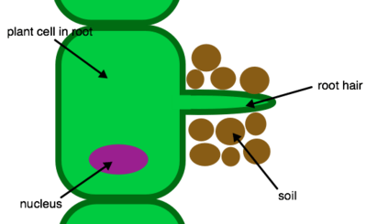
As a further specialisation, some root cells have protrusions called root hairs.
These increase the surface area of the root, which significantly increases the amount of water that can be absorbed from the soil.

Slide 7
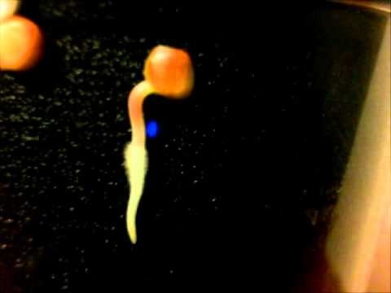

Slide 8
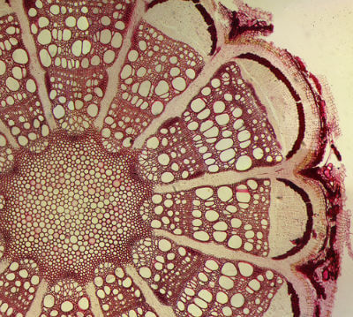
Conducting cells are long thin tubes that resemble drinking straws. They are found inside the stems and roots.
They carry (or "conduct") water from the roots of the plant to the leaves, where it is required for photosynthesis. They also carry food from the leaves to the roots and stems.

Slide 9
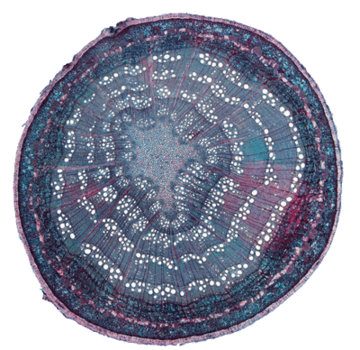
In this cross section of a plant stem, you can actually see the holes formed by the conducting cells!

